Slide 1
Computer Graphics
Department of Software,
Sejong University
Sang Il Park

Slide 2
담당교수소개
담당교수: 박상일 (소프트웨어학과)
연락처
이메일: sipark@sejong.ac.kr
전화: 02-3408-3832
연구실:
장소: 대양AI센터 626호
Office hour: 월/수 16:30~18:00
수업홈페이지:
http://eCampus.sejong.ac.kr

Slide 3
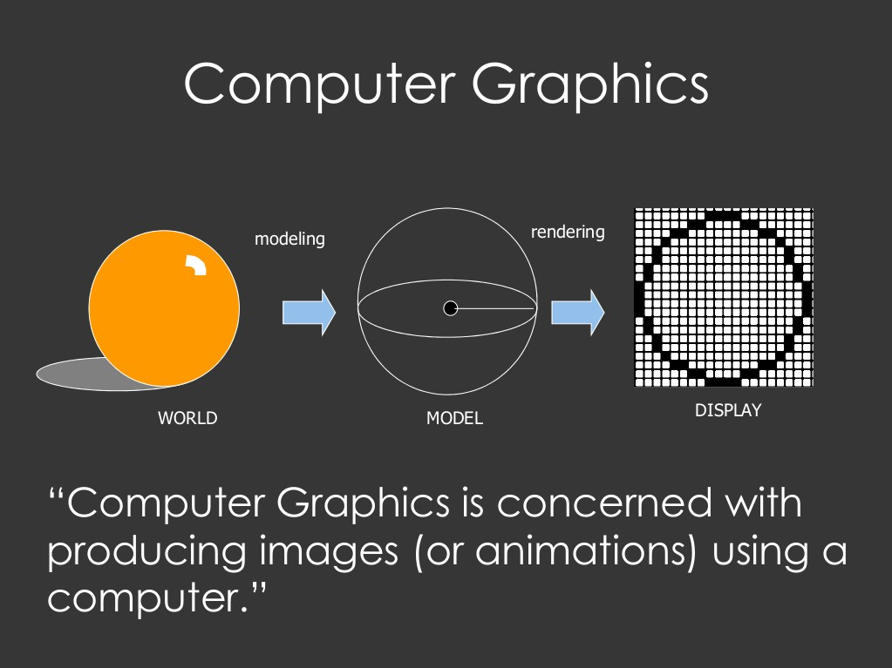

Slide 4
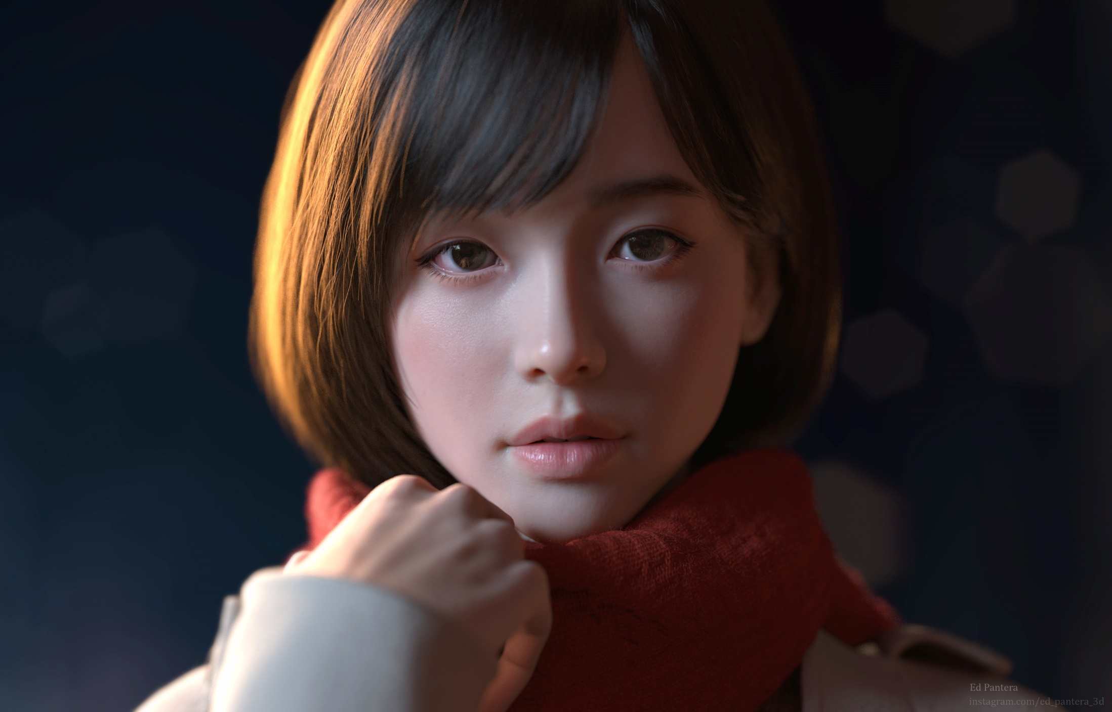
https://www.instagram.com/ed_pantera_3d/

Slide 5
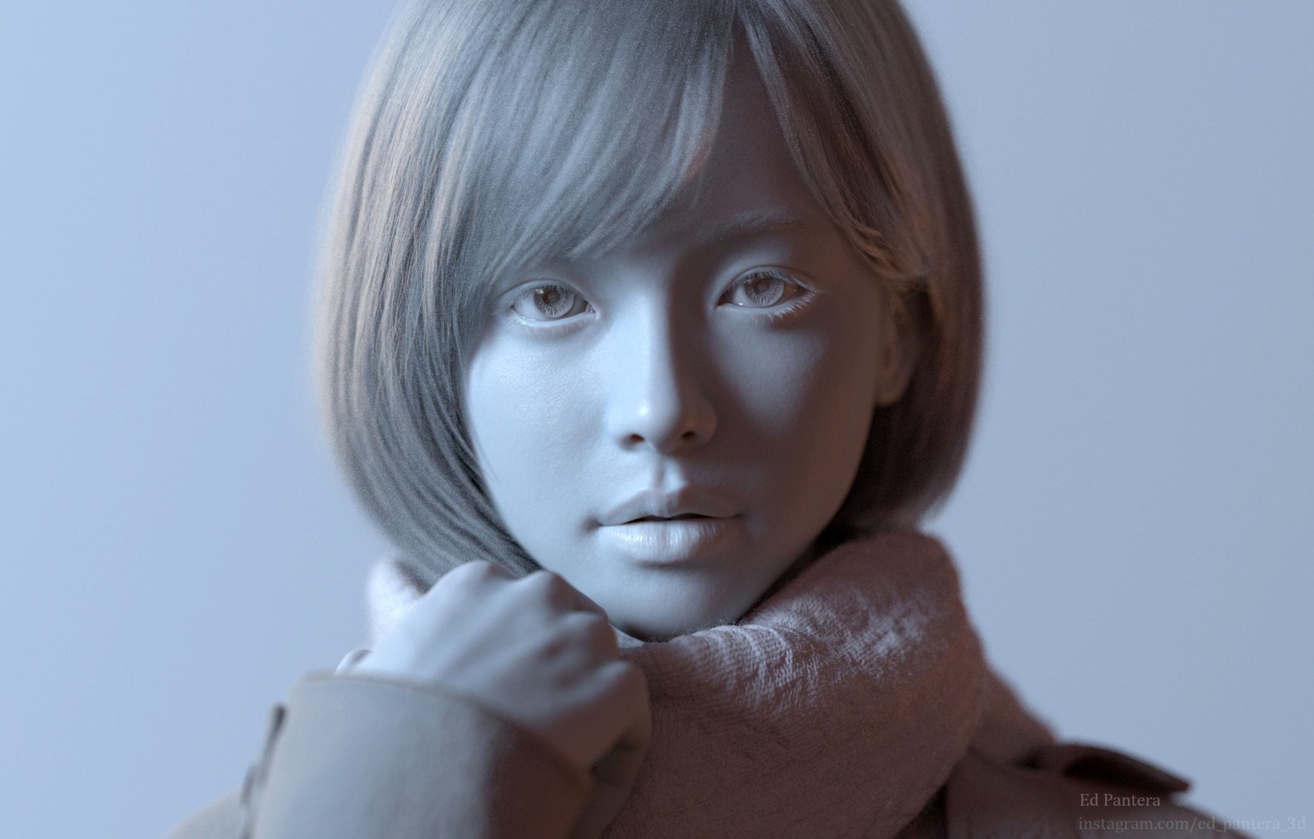
https://www.instagram.com/ed_pantera_3d/

Slide 6
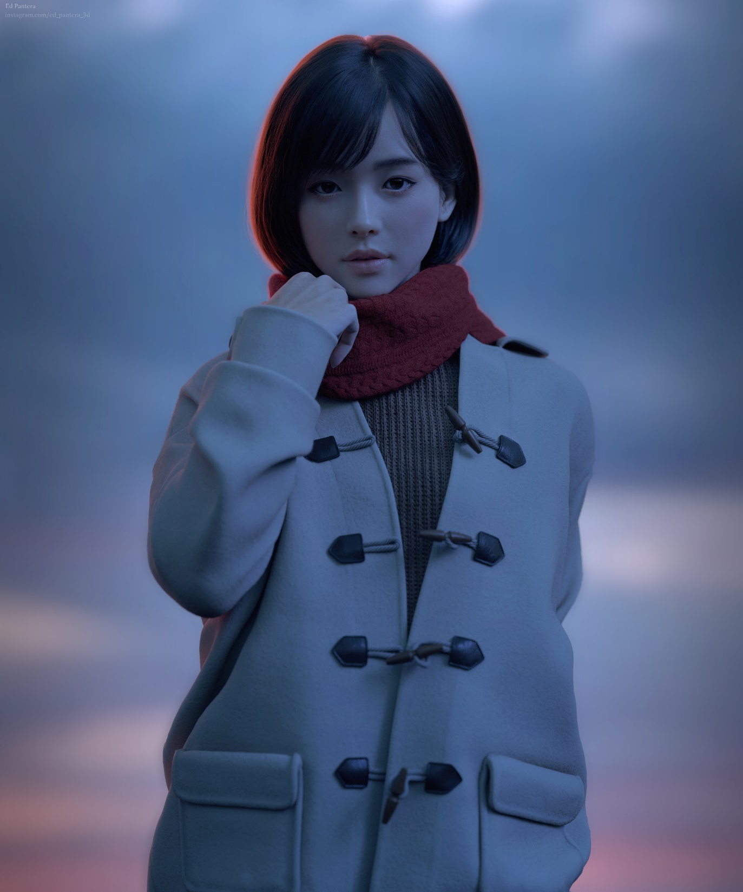
Behind the Scene:
Computer Graphics

Slide 7
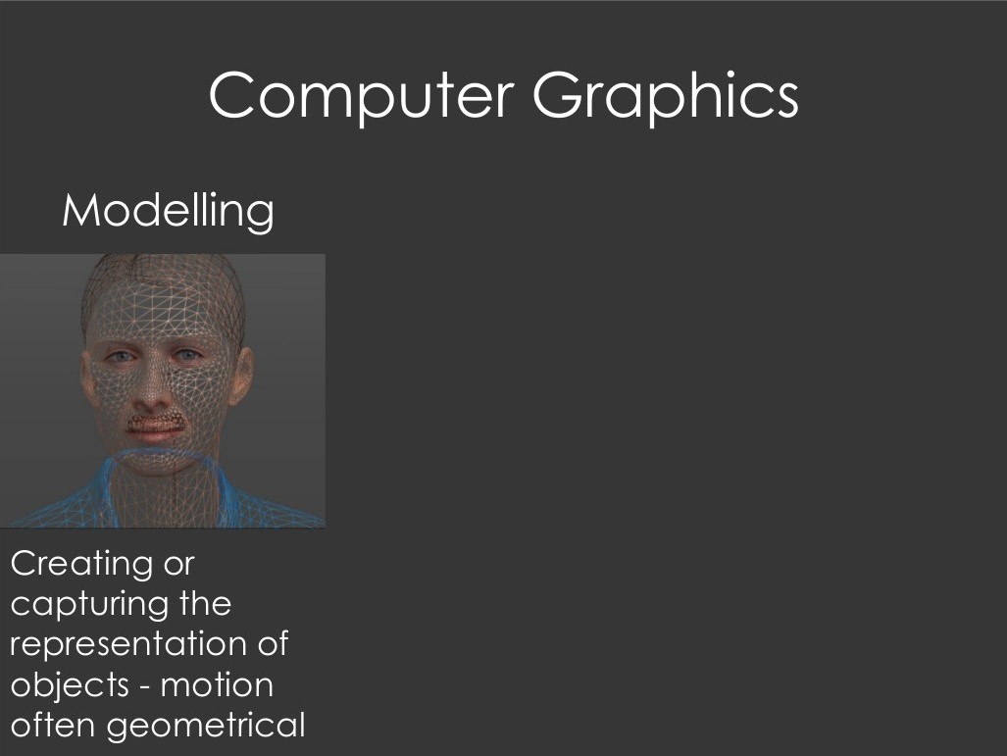

Slide 8
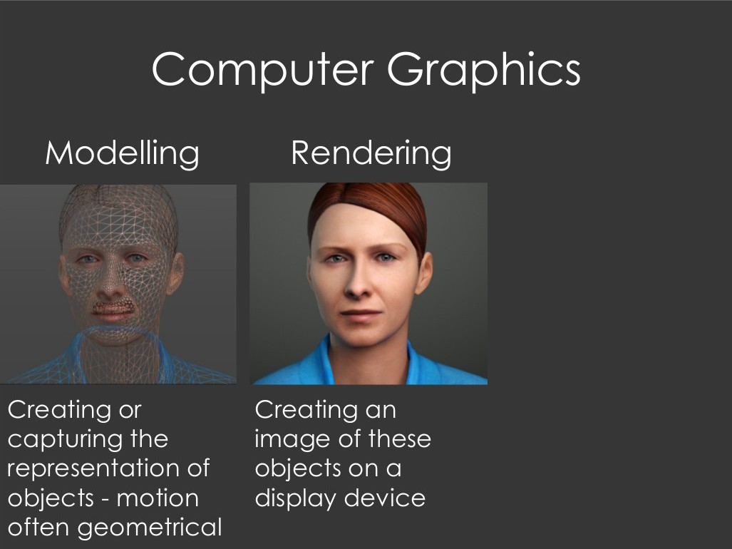

Slide 9
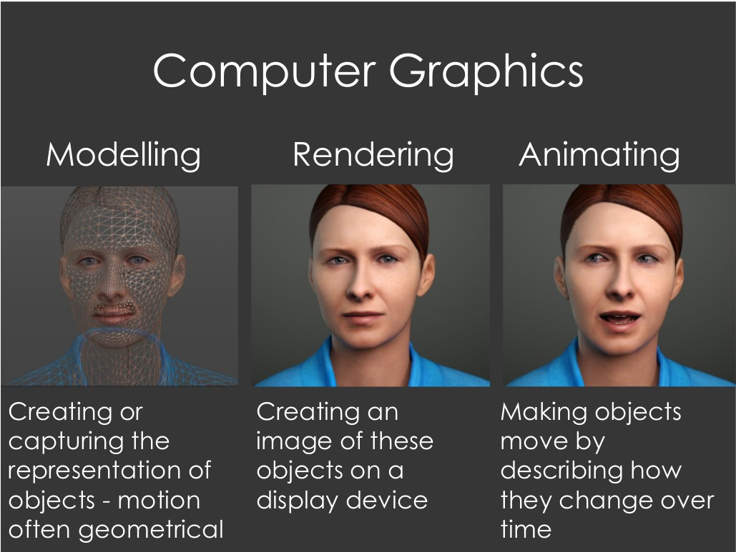

Slide 10
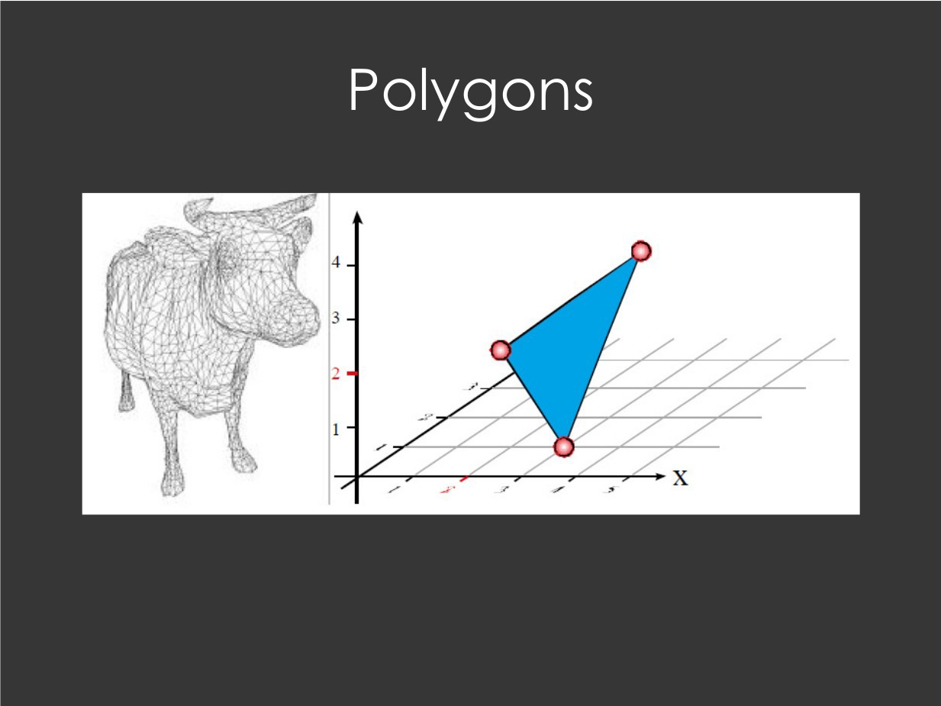

Slide 11
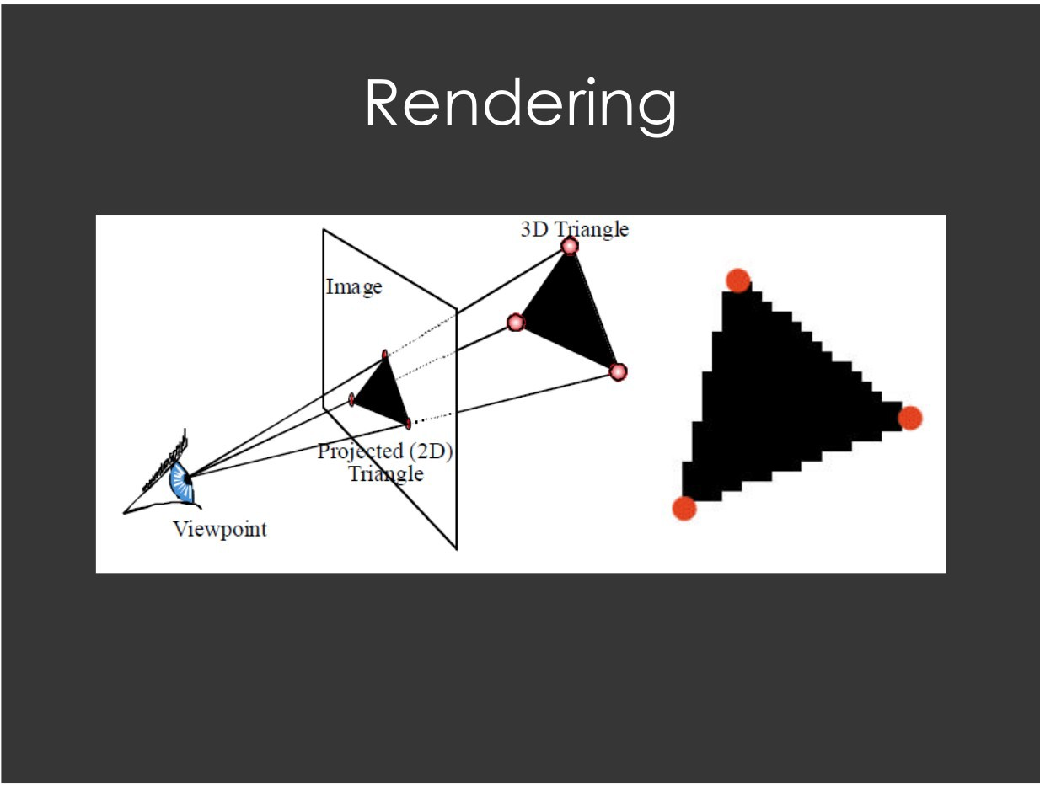

Slide 12
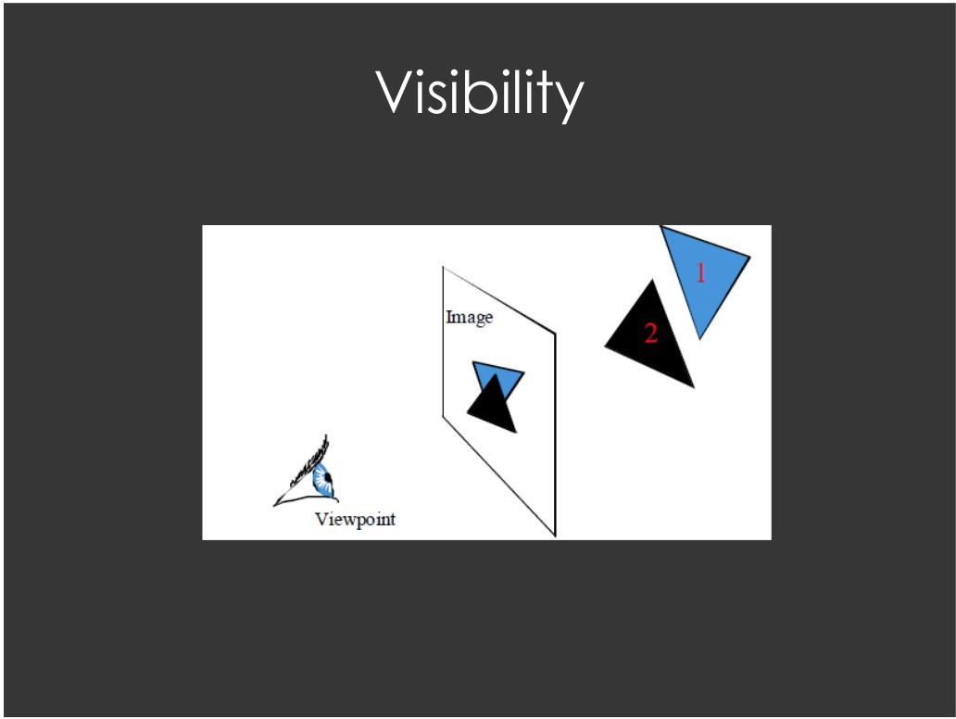

Slide 13
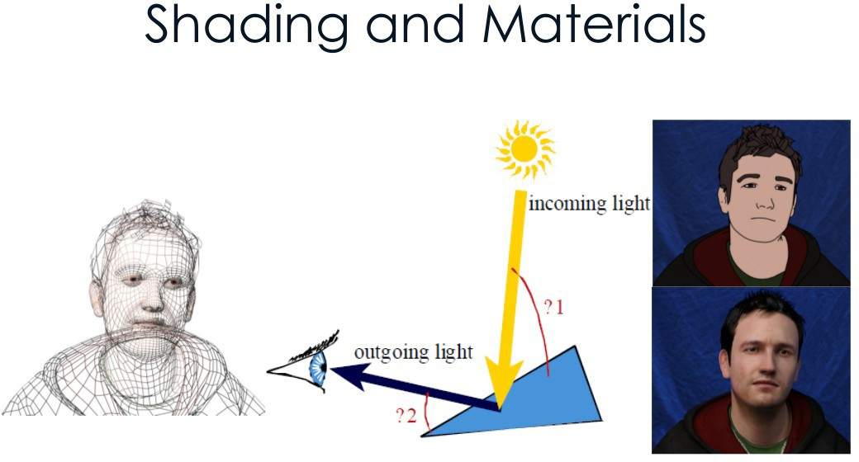

Slide 14
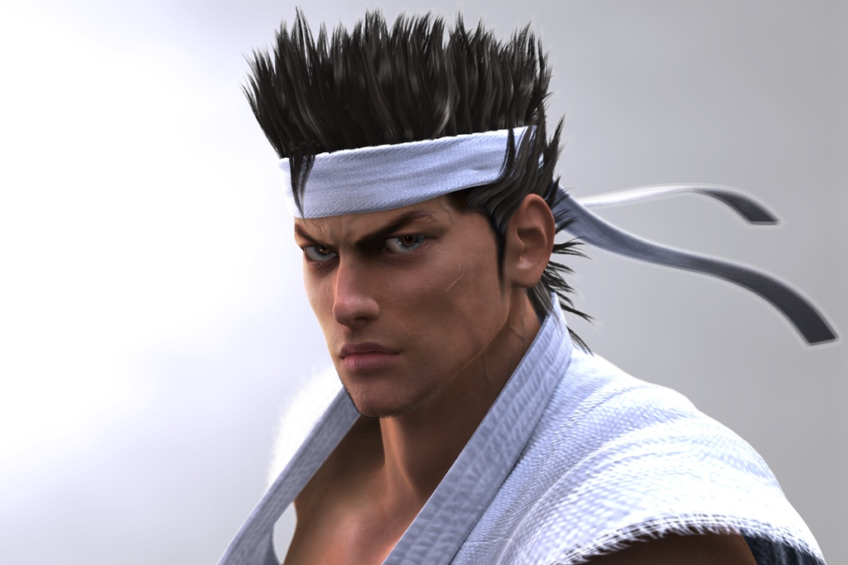
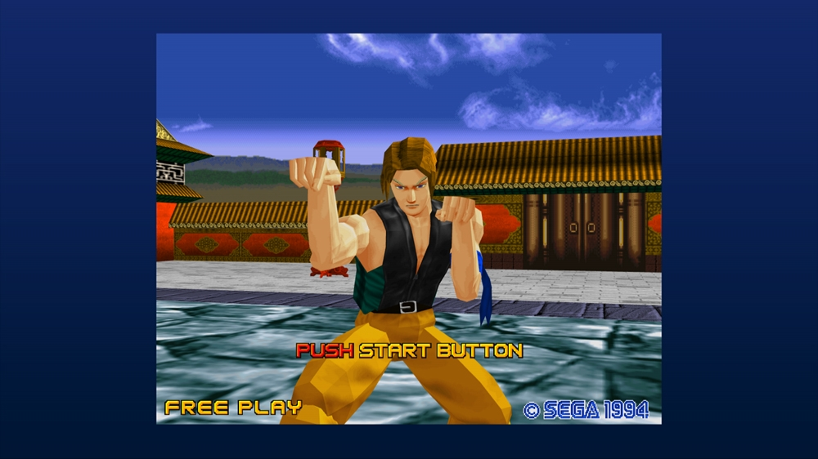
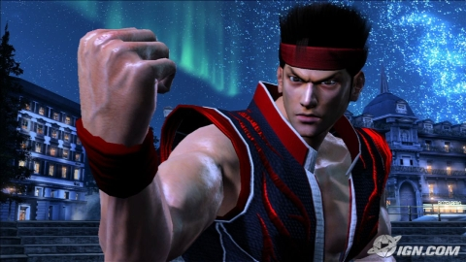
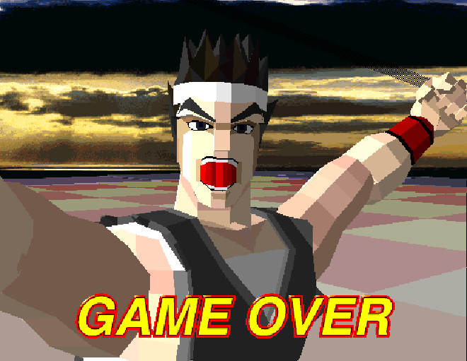
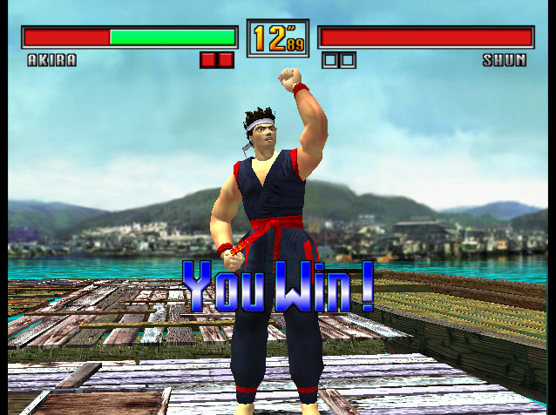
Why do we learn computer graphics
Graphics technology has changed very fast
2006
1994
2002
1993
1996

Slide 15
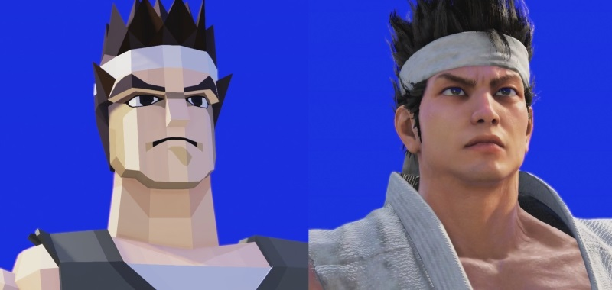
Can you see the differences?

Slide 16
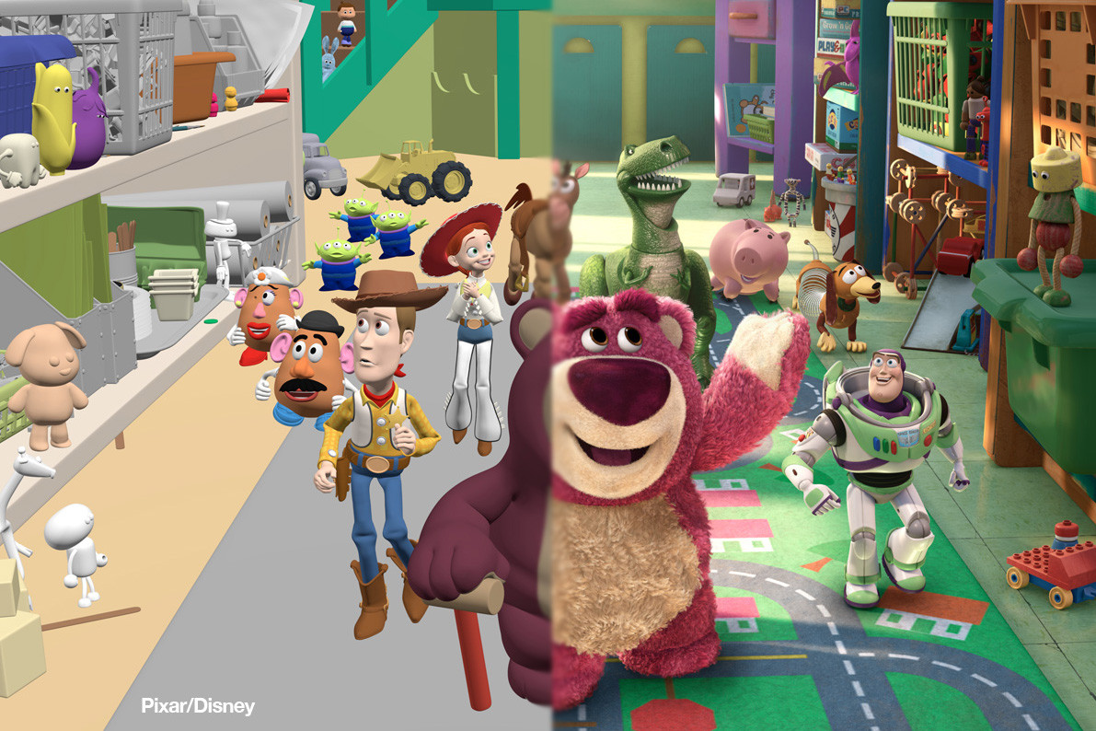
What is in the behind of the scene?

Slide 17
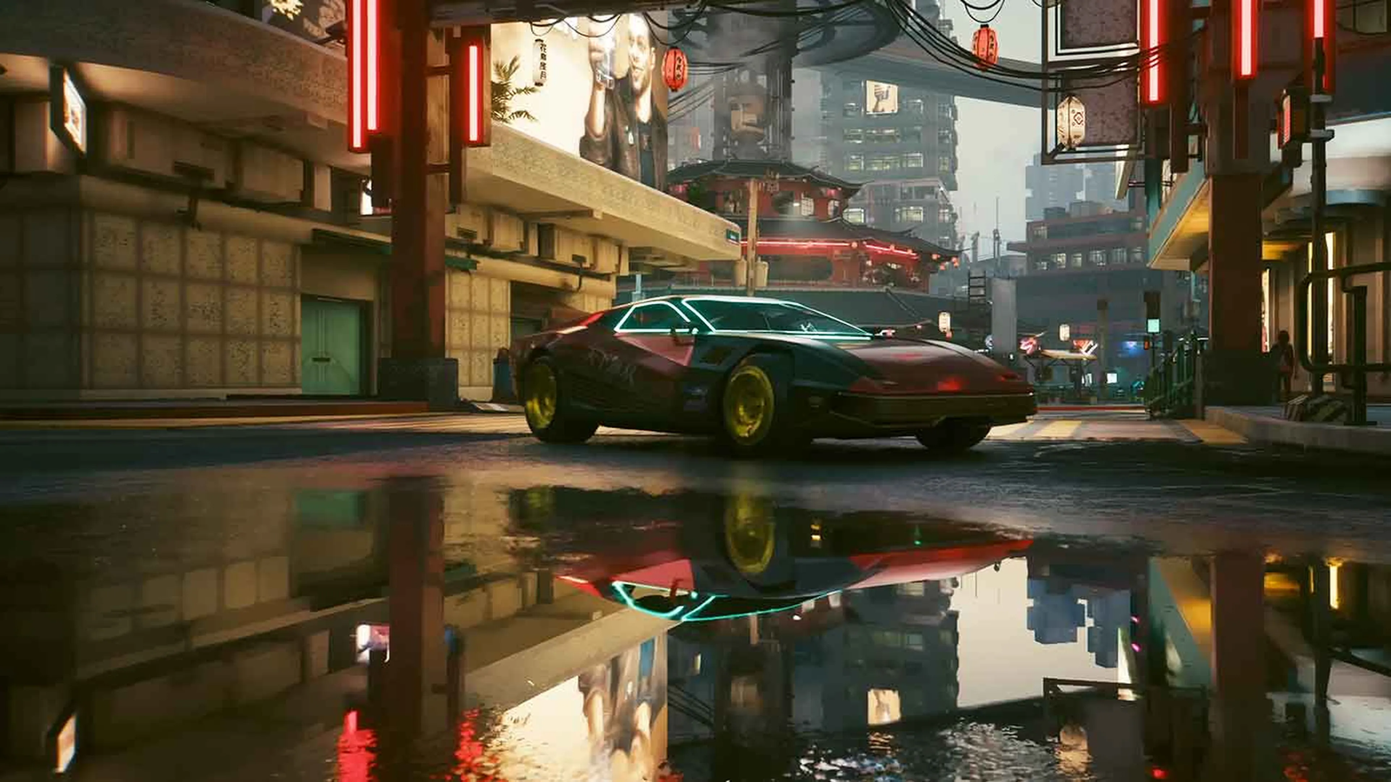
Is this looking good? Why?
https://www.youtube.com/watch?v=Tk7Zbzd-6fs

Slide 18
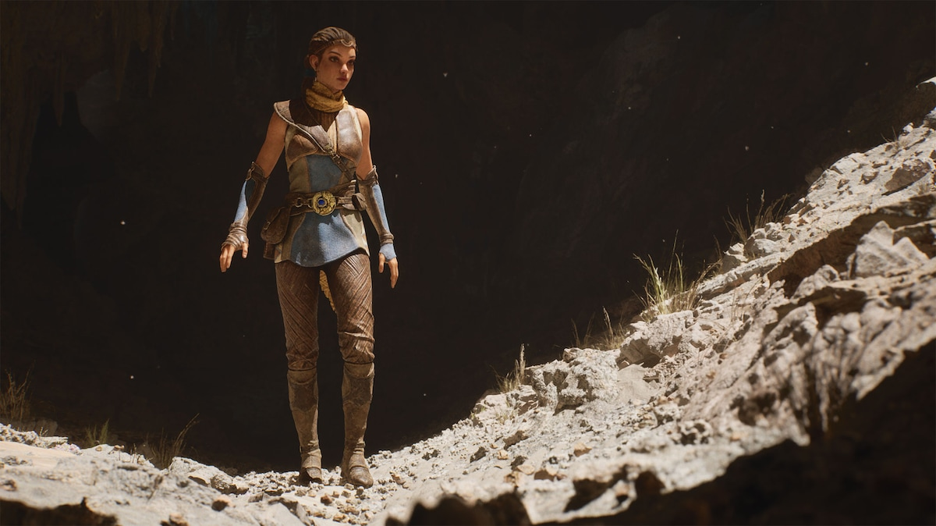
State-of-the-art of real-time graphics
https://youtu.be/qC5KtatMcUw?t=81
https://youtu.be/Dj60HHy-Kqk

Slide 19

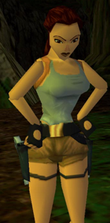
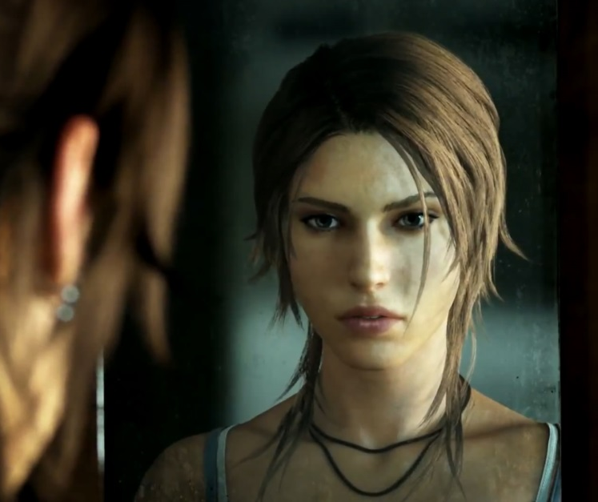
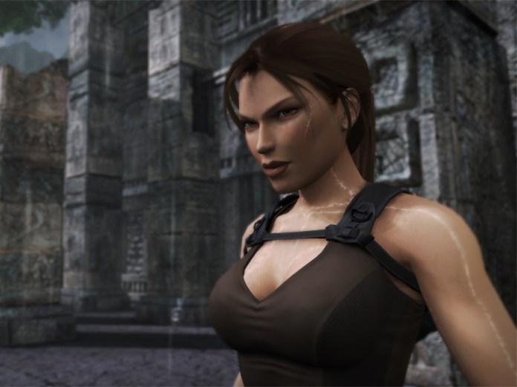
Paradigm changed
OpenGL 1.0 (1994)
OpenGL 2.0 (2004)
OpenGL 3.0 (2008)
OpenGL 4.0 (2010)

Slide 20
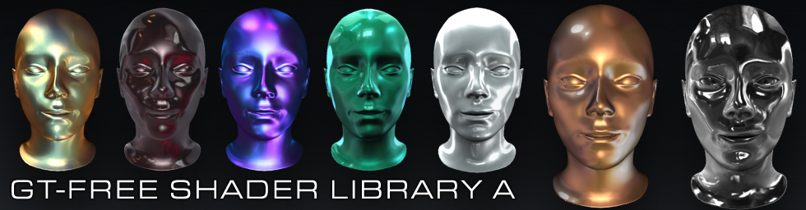
Under the hood: Shaders
A new way to program OpenGL
Before: Fixed Pipeline
After: Programmable pipeline
Modern OpenGL doesn’t support many of the classic things such as “glBegin/glEnd”.
Currently all industries use shaders for their graphics processing

Slide 21
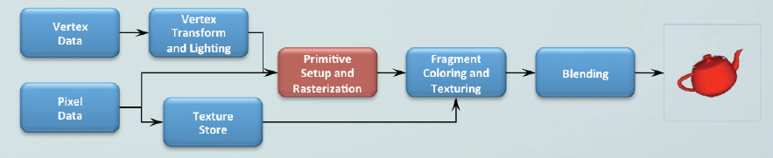
OpenGL 1.0 - 1994
Fixed-function pipeline

Slide 22
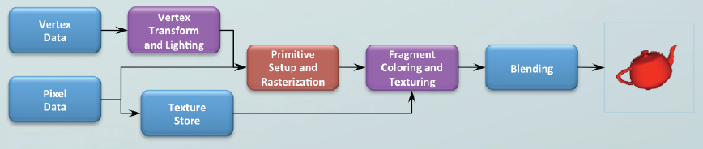
OpenGL 2.0
Officially added programmable pipeline

Slide 23
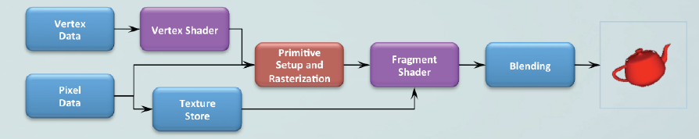
OpenGL 3.1
Removed the fixed-function pipeline

Slide 24
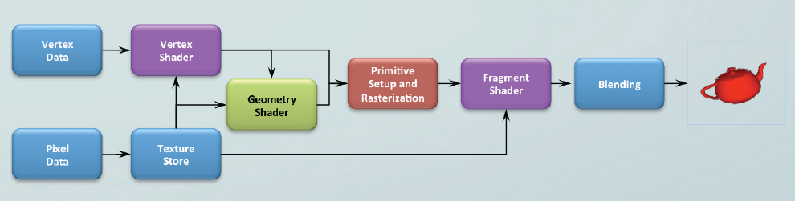
OpenGL 3.2
Additional shading stage : geometry shader

Slide 25
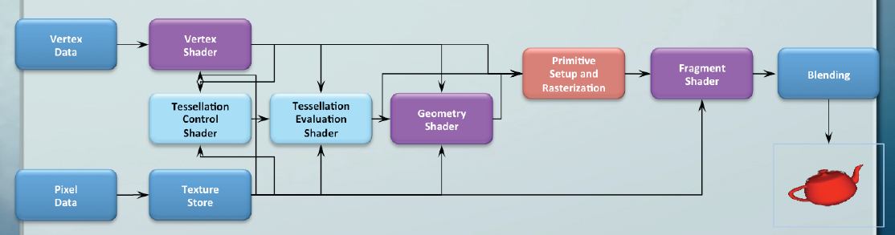
OpenGL 4.5
More of shaders!

Slide 26
WebGL
WebGL
JavaScript implementation of OpenGL
Runs on most recent browsers (Even on your mobiles!)
http://davidwalsh.name/webgl-demo

Slide 27
수업소개
컴퓨터 그래픽스 심화/최신 이론 학습
기본적인 수학/물리 이론들 review
다양한 기하 요소들에 관한 이론 및 활용
프로그래밍 능력 배양
프로그래밍 중심 수업임 (OpenGL 활용)
Modern Graphics Pipeline 연습 : Shader-based OpenGL programming

Slide 28
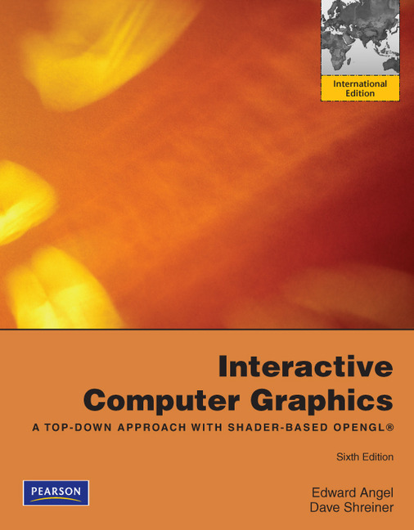
교과서
Interactive Computer Graphics – 6th edition (A top-down approach with shader-based OPENGL) by E. Angel and D. Shreiner

Slide 29
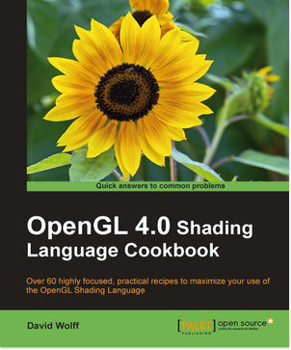
있으면 좋을 책
OpenGL 4.0 Shading Language Cookbook – many interesting examples

Slide 30
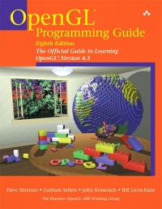
있으면 좋을 책
OpenGL Programming Guide 8th edition (“Red Book”) – everything about OpenGL

Slide 31
수업방법
강의:
이론(50%), 실습(50%), 수시고사 등으로 구성
과제
프로그래밍 (5번 정도 예상)
성적
중간고사(25%)/기말고사(25%)
과제 (50%)
출석 (~10%)
출석은 하루 결석에 전체 총점에서 2점씩, 최대 10점 감점 (6번 이상 결석은 F 처리)
지각 2번은 결석 1번으로 처리

Slide 32
수강필요조건
C/C++ programming skills
Basic Data Structures - linked list, arrays
Linear Algebra - vector/matrix
Multimedia Programming - some experiences in dealing with images and 2D Matrix Transform

Slide 33
시험 방식
주로 필기로 구성 (중간, 기말)
필기: 이론 + 프로그래밍

Slide 34
숙제에 관하여
모든 숙제는 개별 과제 No Collaboration!
Do not copy any parts of any of the assignments from anyone.
Programming Assignments:
eCampus.sejong.ac.kr을 통해 제출
주어진 조건의 구현
예술성을 높이기 위한 추가적인 구현도 적극 권장
늦게 제출할 경우 감점
3일 이상 늦을 경우 받지 않음.

Slide 35
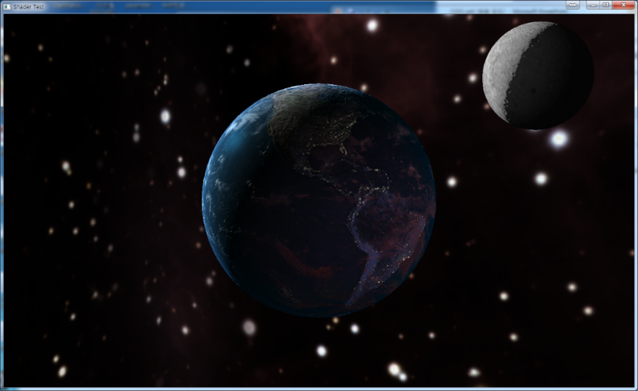
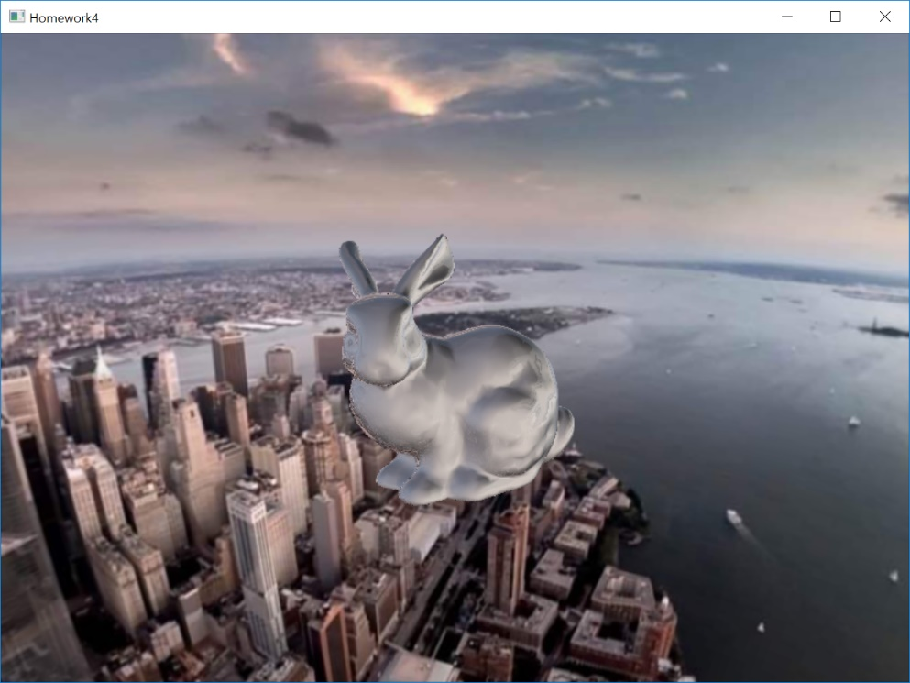
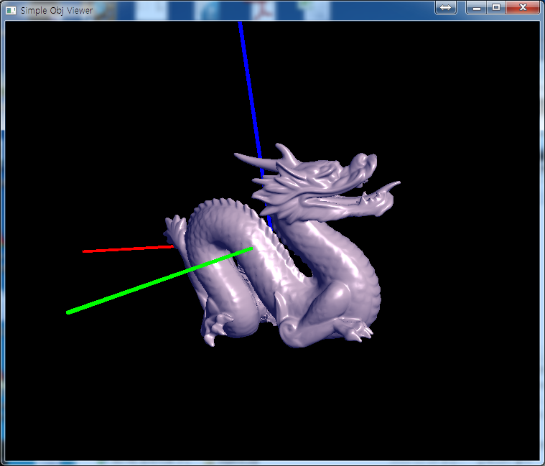
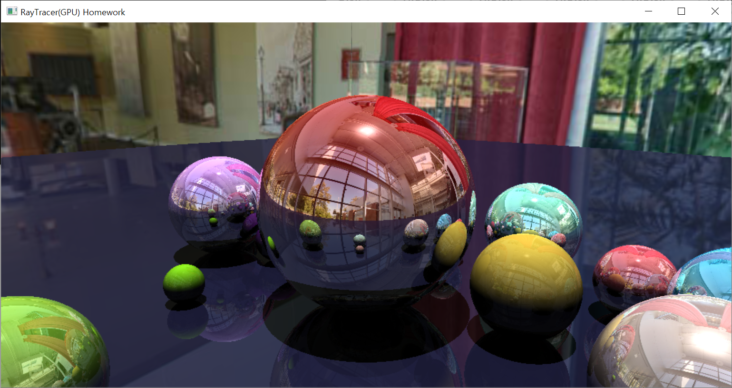
지난 프로그래밍 과제 예시:

Slide 36
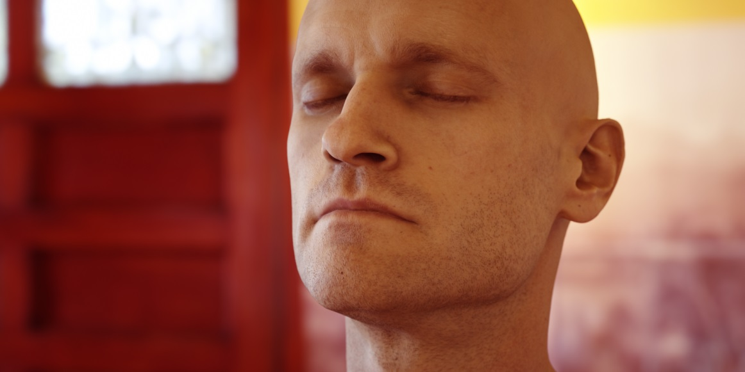
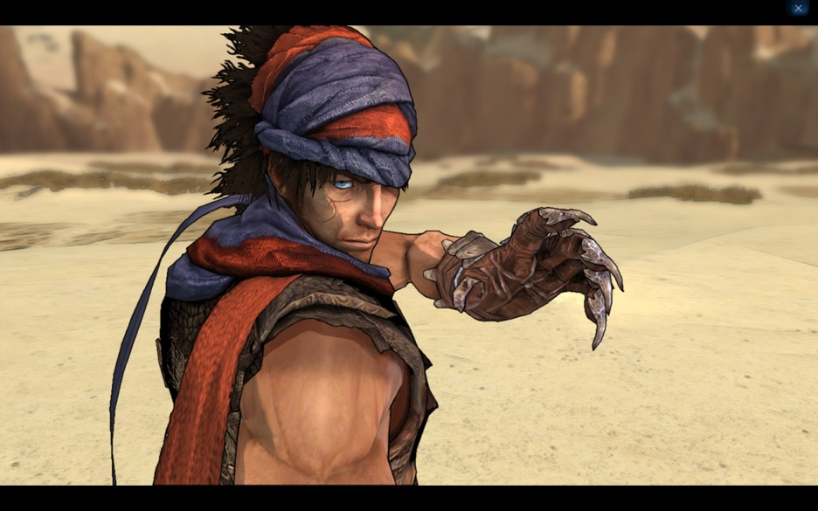
Welcome to the Graphics World!
Creating synthetic images indistinguishable from reality.
Practical, scientifically sound, in real time
Creating your own translation of the reality

Slide 37
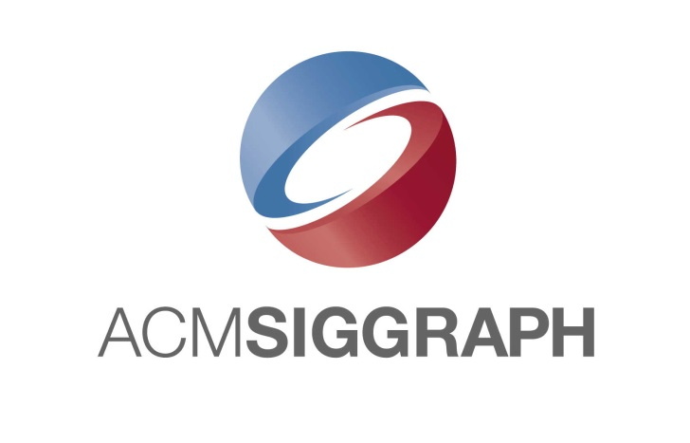
SIGGRAPH
Special Interest Group on Graphics
Main computer graphics event in the world
Once per year
30,000 attendees
Academia, industry
Technical papers in SIGGRAPH 2023: https://youtu.be/VBZ2sDxvZQE
NVidia CEO Keynote at SIGGRAPH 2023: https://youtu.be/Z2VBKerS63A
NVidia Omniverse Address at SIGGRAPH 2023: https://youtu.be/7yjNW04gVMw

Slide 38
See you on this Wednesday
Your very first 3D programming begins
We will learn how to install required libraries.
OpenGL on your computer

